Slide 1
Brown vs. Board of Education Equal Schooling for All
By: Torann Wolfer

Slide 2
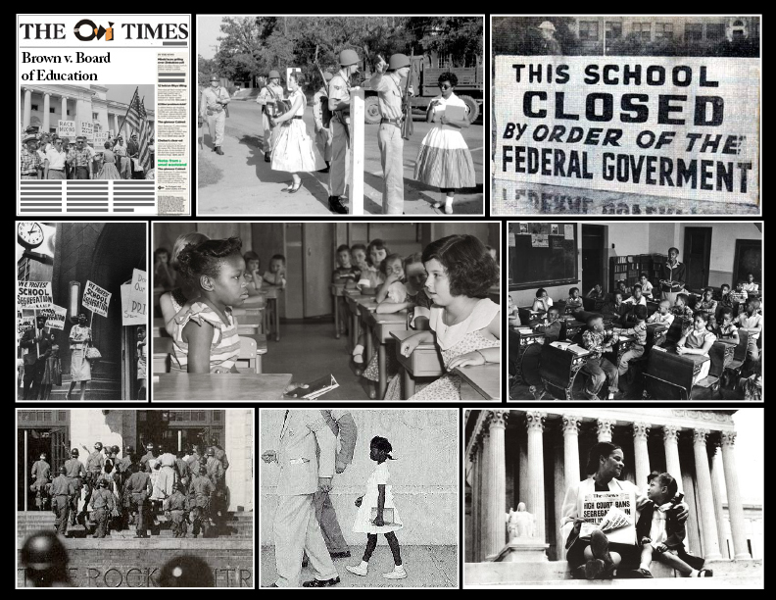
Dates of the Case
Start- 1951
End- May 17, 1954
This Photo by Unknown Author is licensed under CC BY-NC-ND

Slide 3
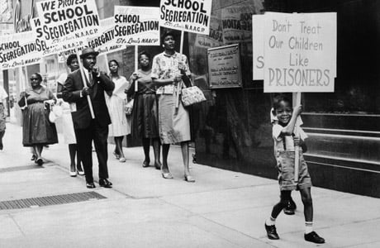
Background Information
In the twentieth century, the National Association for the Advancement of Colored People (NAACP) began a litigation campaign designed to bring an end to state mandated segregation, calling attention to the shabby accommodations provided for blacks, as well as arguing the damaging psychological effects that segregation had on black school children. One case was brought on behalf of Linda Brown, a third-grader from Topeka, Kansas. Several additional school segregation cases were combined into one, known as Brown v. Board of Education. This case reached the Supreme Court in 1953.
This Photo by Unknown Author is licensed under CC BY-NC-ND

Slide 4
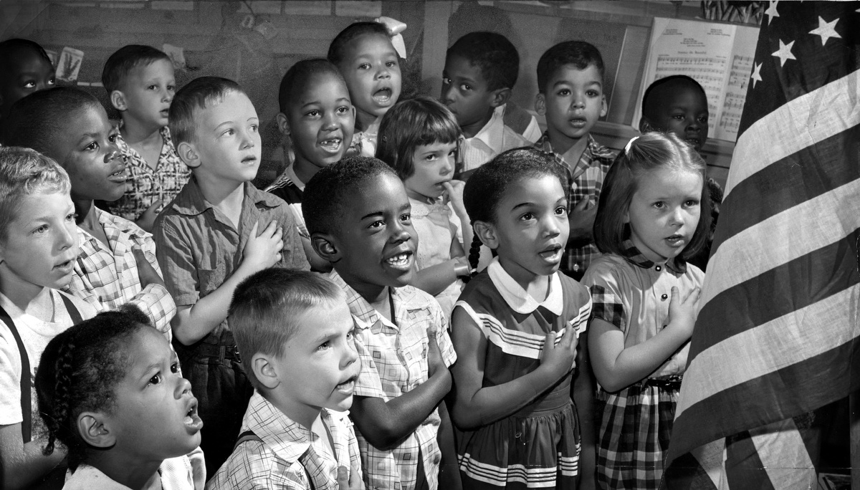
Main Case Facts
At the time of the Brown v. Board of Education ruling, 17 southern and border states, along with the District of Columbia, required their public schools to be racially segregated. An additional four states—Arizona, Kansas, New Mexico and Wyoming—permitted local communities to do the same. Although Black and white schools were supposed to be “separate but equal” in accordance with the Supreme Court’s 1896 Plessy v. Ferguson decision, in reality they were anything but. In 1954 southern Black schools received only 60 percent of the per-pupil funding as southern white schools, up from 45 percent in 1940. Many southern Black schools therefore lacked such basic necessities as cafeterias, libraries, gymnasiums, running water and electricity.
The Supreme Court included no guidance in Brown v. Board of Education on how to actually implement desegregation. Instead, it called for further court discussions, after which it issued a second unanimous ruling in May 1955. Known as Brown II, this seven-paragraph decision tasked local federal judges with making sure that school authorities integrated “with all deliberate speed”—an ambiguous phrase that repudiated the NAACP’s plea for tight deadlines.

Slide 5
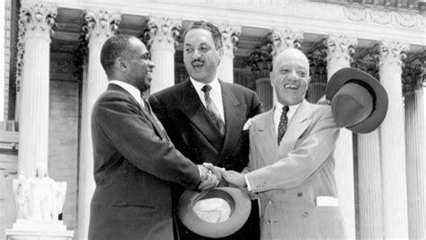
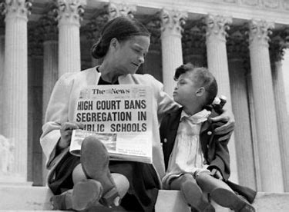
Outcome of the case
The outcome of the Brown v. Board of Education court case led to the desegregation of schools all across the country. The schools in Topeka, Kansas have now been integrated for about 70 years.

Slide 6
Sources
Brown v. Board of Education - Case Background - Bill of Rights Institute
10 Things You Should Know About Brown v. Board of Education - HISTORY

